Slide 1
Ericsson Internship Project Sprint 0 – Code Review
David Martin

Slide 2
System Design - Project Architecture
Web Client
Server
HTML 5
CSS
JavaScript
jQuery
Bootstrap
Http Request
Java EE
Springboot
Framework
using
Maven
Http Response
User Guide / Online Help
AJAX Requests
JSON Data

Slide 3
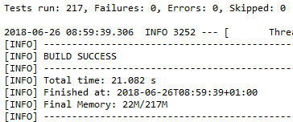
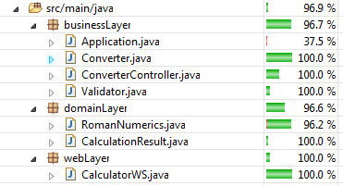
Test Strategy
Web Service:
Web Layer
Spock (Entrypoints)
Cucumber (UAT)
Business Layer
Spock (Mocking)
Domain Layer
Junit
Web Client
GUI – Selenium (Integration tests)

Slide 4
Requirements for Sprint 0
User Story
“As a Roman Bookkeeper, I want to add Roman numbers because doing it manually is too tedious”
As a User, I want to be able to access the System via a web based GUI so that I can add two roman numerals
As a User, I want the GUI to display the correct result when two valid Roman Numerals have been entered as input
As a User, I want the GUI to display an error message where an invalid Roman numeral string has been entered as input
Product Owner requirements
All presented code should be working and clean
All code should be well tested and testing occurs on the correct level of abstraction
The project and code design should be Simple and easy to read.
The project will eventually be transformed into a Microservice using Docker
Sprint 0 will focus on implementing the addition functionality end-to-end
Scrum Board : https://scrumy.com/DavidMartin_MScInternshipProject

Slide 5
Definition of Done
Acceptance criteria is verified during testing
90%+ Code coverage
All tests are automated and passing
The Master Branch shall always be in a working state (e.g. fully functional with all tests passing)

Slide 6
Validation of Rules of Roman Numerals
Regular Expression used for Validation :
^(M{0,3}(CM|CD|D?C{0,3})(XC|XL|L?X{0,3})(IX|IV|V?I{0,3})$
Example of hundreds validation
100: C matched by D?C{1} (with D not there)
200: CC matched by D?C{2} (with D not there)
300: CCC matched by D?C{3} (with D not there)
400: CD matched by CD
500: D matched by D?C{0} (with D there)
600: DC matched by D?C{1} (with D there)
700: DCC matched by D?C{2} (with D there)
800: DCCC matched by D?C{3} (with D there)
900: CM matched by CM
The same checking is then applied to 10’s and finally single roman numeral digits
Ref : https://stackoverflow.com/questions/267399/how-do-you-match-only-valid-roman-numerals-with-a-regular-expression

